Slide 1

Introduction to Digital Forensics
Presented By: Stephanie Du
Computer Science & Engineering
September 23rd, 2025
CYBER SECURITY INITIATIVE FOR NEVADA TEACHERS (CSINT)
CS 151.1001 – Fall 2025
Notes:
Welcoming (“Good afternoon everyone…”)
Introduction
School Status (i.e., Major, Minor, Career Path, etc.)
Background (I.e., where you from, why cybersecurity, etc.)
Interesting Fact About Yourself (i.e., I like cats, and I taught my cat how to fetch)
Script:
So today, I will be giving an overview of digital forensics and its importance in the cyber sphere. I will be covering things such as the procedure of gathering evidence, different types of forensic techniques, and at the end we will be using a software package to look at hidden data within files (i.e., jpg, png, pdf, etc.)

Slide 2
Digital Forensics
How would you define
Digital Forensics?
CS 151 - Fall 2018
CS 151.1001 – Fall 2025
Notes:
Script:
Throughout the session, we typically start our lectures with quotes, just to get brains in the proper investigative mindset.
Digital Forensics is very similar to regular (physical) forensics where you have to gather physical evidence, worry about chain of custody, and essentially anything that will provide a solid backing to your investigation so that your findings can be used professionally in a court of law. (i.e., drafting a investigation report, making compelling arguments).
Sometimes digital forensics is art, just as much as a science, just because you might not always find the “smoking gun” right away; so, you have to piece things together like a puzzle.
* Ask about NIST (National Institute of Standards and Technology). Explain what NIST is. (i.e., establish regulations and standards for public agencies to reference (security vs. privacy)). They have background in digital forensics and post materials for people to use/test to familiarize themselves with the process.
----------
Additional Notes:
Digital Forensics, Computer Forensics, Cyber Forensics, and Network Forensics are all considered the same science.
It is important to note that Digital Forensics is a multi-step procedure that involves collection, preservation, and analysis.
NIST – National Institute of Standards and Technology

Slide 3
Digital Forensics
“Cyber Forensics is the acquisition, preservation and analysis of Electronically Stored Information (ESI) in such a way that ensures its admissibility for use as either evidence, exhibits, or demonstratives in a court of law.”
-- Scott Ellis, Kcura Corporation
“[Digital Forensics] is considered the application of science to the identification, collection, examination, and analysis of data while preserving the integrity of the information and maintaining a strict chain of custody for the data.“
-- NIST, Integrating Forensic Techniques into Incident Response
CS 151 - Fall 2018
CS 151.1001 – Fall 2025
Notes:
Script:
Throughout the session, we typically start our lectures with quotes, just to get brains in the proper investigative mindset.
Digital Forensics is very similar to regular (physical) forensics where you have to gather physical evidence, worry about chain of custody, and essentially anything that will provide a solid backing to your investigation so that your findings can be used professionally in a court of law. (i.e., drafting a investigation report, making compelling arguments).
Sometimes digital forensics is art, just as much as a science, just because you might not always find the “smoking gun” right away; so, you have to piece things together like a puzzle.
* Ask about NIST (National Institute of Standards and Technology). Explain what NIST is. (i.e., establish regulations and standards for public agencies to reference (security vs. privacy)). They have background in digital forensics and post materials for people to use/test to familiarize themselves with the process.
----------
Additional Notes:
Digital Forensics, Computer Forensics, Cyber Forensics, and Network Forensics are all considered the same science.
It is important to note that Digital Forensics is a multi-step procedure that involves collection, preservation, and analysis.
NIST – National Institute of Standards and Technology

Slide 4
Forensic Procedures
Collection
Examination
Analysis
Reporting
CS 151 - Fall 2018
CS 151.1001 – Fall 2025
Notes:
Additional Notes:
There are several models for Forensics Procedures (some of them have 5 stages, some of them have 7, in this case we have narrowed down into 4 stages). In all cases the data must be identified, acquired, examined, verified, analyzed, documented and presented.
It’s important for students to be able to communicate their findings and understanding to other people (not just finding the evidence without a formal report)

Slide 5

Forensic Procedures
Collection Examination Analysis Reporting
Notification and Authorization
Data Owner
Legal Issues
Objectives
CS 151 - Fall 2018
CS 151.1001 – Fall 2025
Notes:
Script:
The first stage is Collection. Students often overlook this step because they want to get straight into the tools and techniques right away, when they should really be looking at the bigger picture. Knowing how to handle tools is important; however, knowing how it all started (i.e., logistics, policies, precedents, etc.) is arguably more important as it establishes professional credibility. You can find a lot of incriminating evidence, but at the end of the day, if you’re standing in a courtroom and you are unable to tell the judge the owner of the device, then all of your work becomes voided. There’s a lot there that needs to be thought about, so it’s important to not just teach the kids how to handle technology, but as mentioned before, how to communicate their findings as a fellow professional.
* Talk about the Collection Process.
Effort vs. Value: “Not everything is in black and white, lots of gray area.”, “You can’t find everything… focus on concrete evidence”
----------
Additional Notes:
Data acquisition must adhere to civil, criminal, international laws, etc.
Volatile memory must be analyzed first.
Bytes and bytes of data available – decisions need to be made on time and money spent, where efforts are focused.
Many places evidence can be found: mobile devices, external drives, social media

Slide 6

Forensic Procedures
Collection Examination Analysis Reporting
Identifying Data Sources
Hard Drives / Memory
External Devices
Cloud Data
CS 151 - Fall 2018
CS 151.1001 – Fall 2025
Notes:
Script:
The first stage is Collection. Students often overlook this step because they want to get straight into the tools and techniques right away, when they should really be looking at the bigger picture. Knowing how to handle tools is important; however, knowing how it all started (i.e., logistics, policies, precedents, etc.) is arguably more important as it establishes professional credibility. You can find a lot of incriminating evidence, but at the end of the day, if you’re standing in a courtroom and you are unable to tell the judge the owner of the device, then all of your work becomes voided. There’s a lot there that needs to be thought about, so it’s important to not just teach the kids how to handle technology, but as mentioned before, how to communicate their findings as a fellow professional.
* Talk about the Collection Process.
Effort vs. Value: “Not everything is in black and white, lots of gray area.”, “You can’t find everything… focus on concrete evidence”
----------
Additional Notes:
Data acquisition must adhere to civil, criminal, international laws, etc.
Volatile memory must be analyzed first.
Bytes and bytes of data available – decisions need to be made on time and money spent, where efforts are focused.
Many places evidence can be found: mobile devices, external drives, social media

Slide 7

Forensic Procedures
Collection Examination Analysis Reporting
Order of Acquisition
Effort vs. Value
2
1
RAM / Memory
CPU Registers / Cache
4
3
External Storage Devices
Hard Drive
CS 151 - Fall 2018
CS 151.1001 – Fall 2025
Notes:
Script:
The first stage is Collection. Students often overlook this step because they want to get straight into the tools and techniques right away, when they should really be looking at the bigger picture. Knowing how to handle tools is important; however, knowing how it all started (i.e., logistics, policies, precedents, etc.) is arguably more important as it establishes professional credibility. You can find a lot of incriminating evidence, but at the end of the day, if you’re standing in a courtroom and you are unable to tell the judge the owner of the device, then all of your work becomes voided. There’s a lot there that needs to be thought about, so it’s important to not just teach the kids how to handle technology, but as mentioned before, how to communicate their findings as a fellow professional.
* Talk about the Collection Process.
Effort vs. Value: “Not everything is in black and white, lots of gray area.”, “You can’t find everything… focus on concrete evidence”
----------
Additional Notes:
Data acquisition must adhere to civil, criminal, international laws, etc.
Volatile memory must be analyzed first.
Bytes and bytes of data available – decisions need to be made on time and money spent, where efforts are focused.
Many places evidence can be found: mobile devices, external drives, social media

Slide 8

Forensic Procedures
Collection Examination Analysis Reporting
Extracting Evidence
“Image” Device
Always work on a copy
CS 151 - Fall 2018
CS 151.1001 – Fall 2025
Notes:
Additional Notes:
Evidence must be copied and the copied data examined so as to preserve original data.
Several types of tools available
Tools need to be validated to be sure the analysis is correct.

Slide 9
Forensic Images
Forensic Images - a bit-by-bit exact copy of the memory space of the device to be examined.
Hash Values - a unique numeric value of fixed length acquired through the application of a mathematical algorithm on digital data, used for ensuring data integrity.
CS 151 - Fall 2018
CS 151.1001 – Fall 2025
Notes:
Additional Notes:
All digital artifacts are analyzed on the forensic image so as to neither introduce nor delete digital evidence.
Write blockers stop changes being made to the original device when making a forensic image. There are software and hardware write blockers.
Hashing is applied to the original device and the image to ensure no changes have been made.

Slide 10
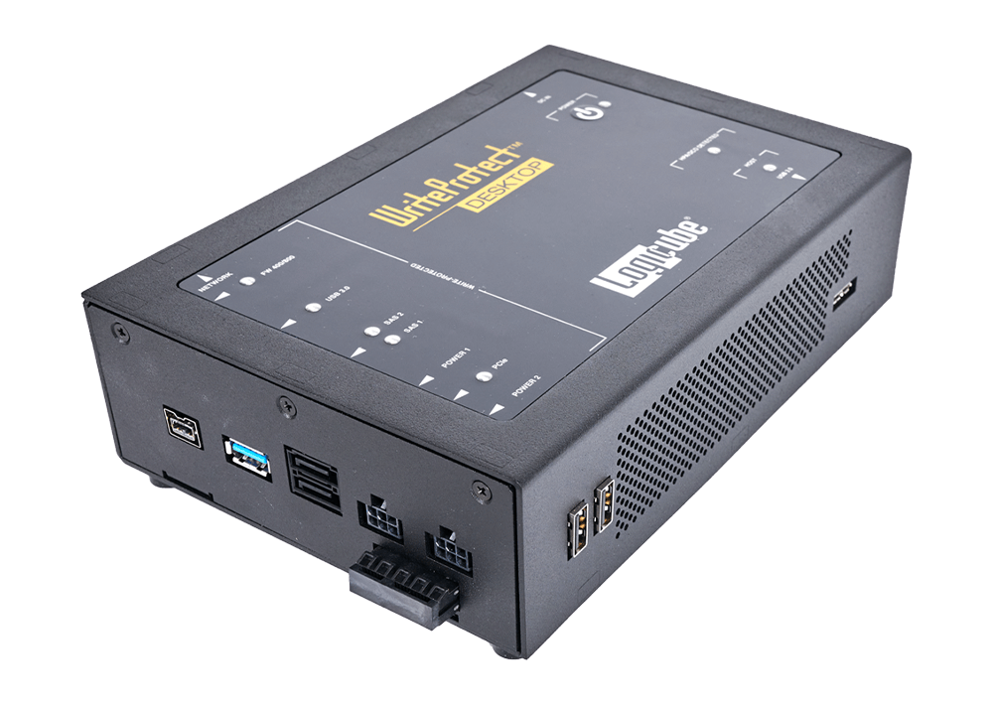
Forensic Procedures
Collection Examination Analysis Reporting
Tools Needed
Write Blockers
Image Analyzers
Hex Editors
Tool Validation
https://www.logicube.com/shop/writeprotect-desktop/
CS 151 - Fall 2018
CS 151.1001 – Fall 2025
Notes:
Additional Notes:
Evidence must be copied and the copied data examined so as to preserve original data.
Several types of tools available
Tools need to be validated to be sure the analysis is correct.

Slide 11
Forensic Tools
Write Blockers - devices that are used to stop any changes being made to the original device when making a forensic image.
Image Analyzers – software that previews, organizes and/or extracts data to allow for examination of digital artifacts originating from forensic images.
CS 151 - Fall 2018
CS 151.1001 – Fall 2025
Notes:
Additional Notes:
All digital artifacts are analyzed on the forensic image so as to neither introduce nor delete digital evidence.
Write blockers stop changes being made to the original device when making a forensic image. There are software and hardware write blockers.
Hashing is applied to the original device and the image to ensure no changes have been made.

Slide 12
Forensic Tools
Forensics Tools – digital forensic tools created by software developers for in-depth investigations.
Disk and Data Capture Tools
File Viewers
File, Registry, Internet and Email Analysis
Mobile Devices Analysis Tools
Network Forensics Tools
Tool Validation – the verification of the software and technology used to perform a digital forensics investigation.
Hashing to Validate Results
Multiple Tools or Techniques
Manual Carving for Control or Validation
Forensics Tool Testing Programs
CS 151 - Fall 2018
CS 151.1001 – Fall 2025

Slide 13
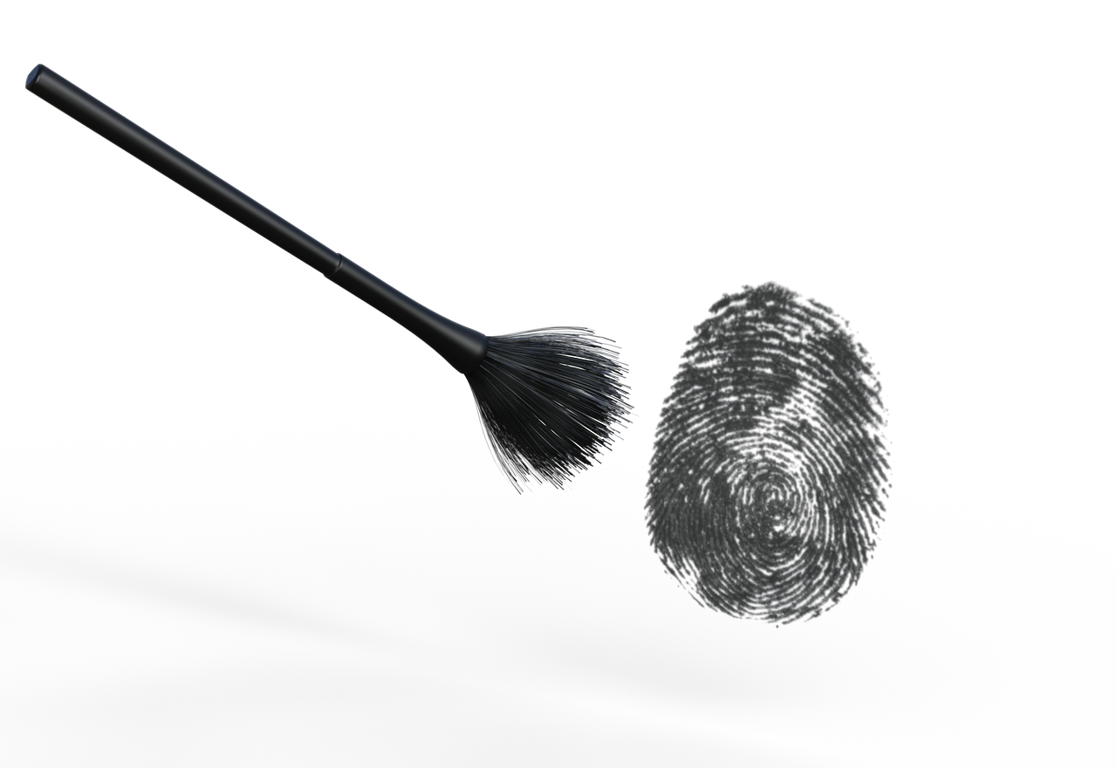
Forensic Procedures
Collection Examination Analysis Reporting
Analysis
Artifacts and Devices
Relevant Information
Timeline
Process and Methods
Integrity of Data
CS 151 - Fall 2018
CS 151.1001 – Fall 2025
Notes:
Additional Notes:
Process needs to be legally justifiable method and techniques
Relevance is based on the scope and objective of the investigation
Integrity of data includes imaging and chain of custody
Conclusions may include recommendations
Technical Writing vs. Creative Writing: no need for fancy words

Slide 14
Forensic Artifacts
Forensic Artifacts - digital evidence, an object of digital archeological interest.
Documents
Contact Lists, Emails
Calendars
Browser History, Cookies, and Bookmarks
Pictures, Images, and Digital Photos
Audio and Video Files
Thumbnails
Hidden, System and Temporary Files
Other Data Sources
[Mobile Devices]
[Virtual Machines]
CS 151 - Fall 2018
CS 151.1001 – Fall 2025
Notes:
Additional Notes:
There are several types of forensics artifacts. Not all cases are able to acquire all types or even analyze all types.
Different operating systems store artifacts in different places
Mobile Devices and Virtual Machines are not artifacts in and of themselves but rather important locations where artifacts can be found

Slide 15
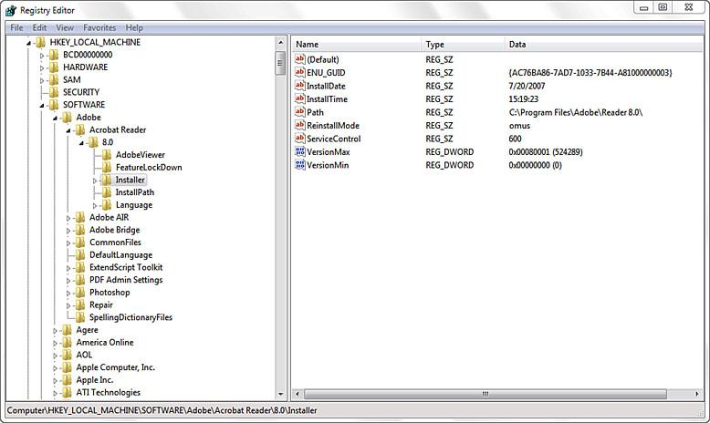
Registry
Registry - A central hierarchical database used in Microsoft Windows to store information that is necessary to configure the system for one or more users, applications and hardware devices.
CS 151 - Fall 2018
CS 151.1001 – Fall 2025
Notes:
Additional Notes:
The Registry contains information that Windows continually references during operation, such as profiles for each user, the applications installed on the computer and the types of documents that each can create, property sheet settings for folders and application icons, what hardware exists on the system, and the ports that are being used.
A registry hive is a group of keys, subkeys, and values in the registry that has a set of supporting files that contain backups of its data, e.g. HKEY_CURRENT_USER
Ask if they are familiar with RegEdit

Slide 16
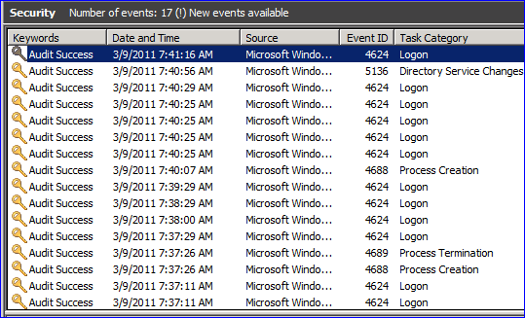
Event Logs
Event Logs - log files are special files that record significant events, e.g. logins or program errors.
CS 151 - Fall 2018
CS 151.1001 – Fall 2025
Notes:
Additional Notes:
Windows log shown and discussed, but all operating systems have them
Error, warning, information, success/failure audit
Can be viewed with Event Viewer
Logs roll over!

Slide 17
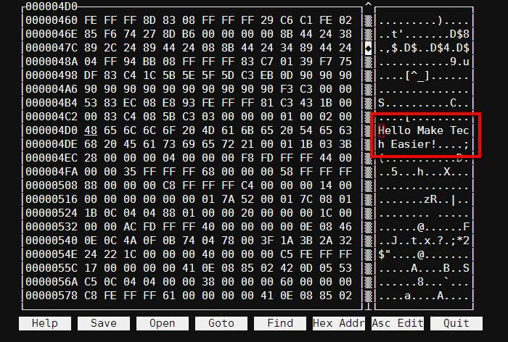
Hex Editor
Hex Editor - A hex editor is a software tool used to directly view and modify the binary data (shown in hexadecimal format) of files.
CS 151 - Fall 2018
CS 151.1001 – Fall 2025
Notes:
Additional Notes:
Program that allows for manipulation of the fundamental binary data that constitutes a computer file.
“Hex” stands for 'hexadecimal’ a base 16 number system with 0-9 and A-F.
Hexadecimal is a standard numerical format for representing binary data.
The hex data for a file can be manipulated to help recover deleted files.

Slide 18
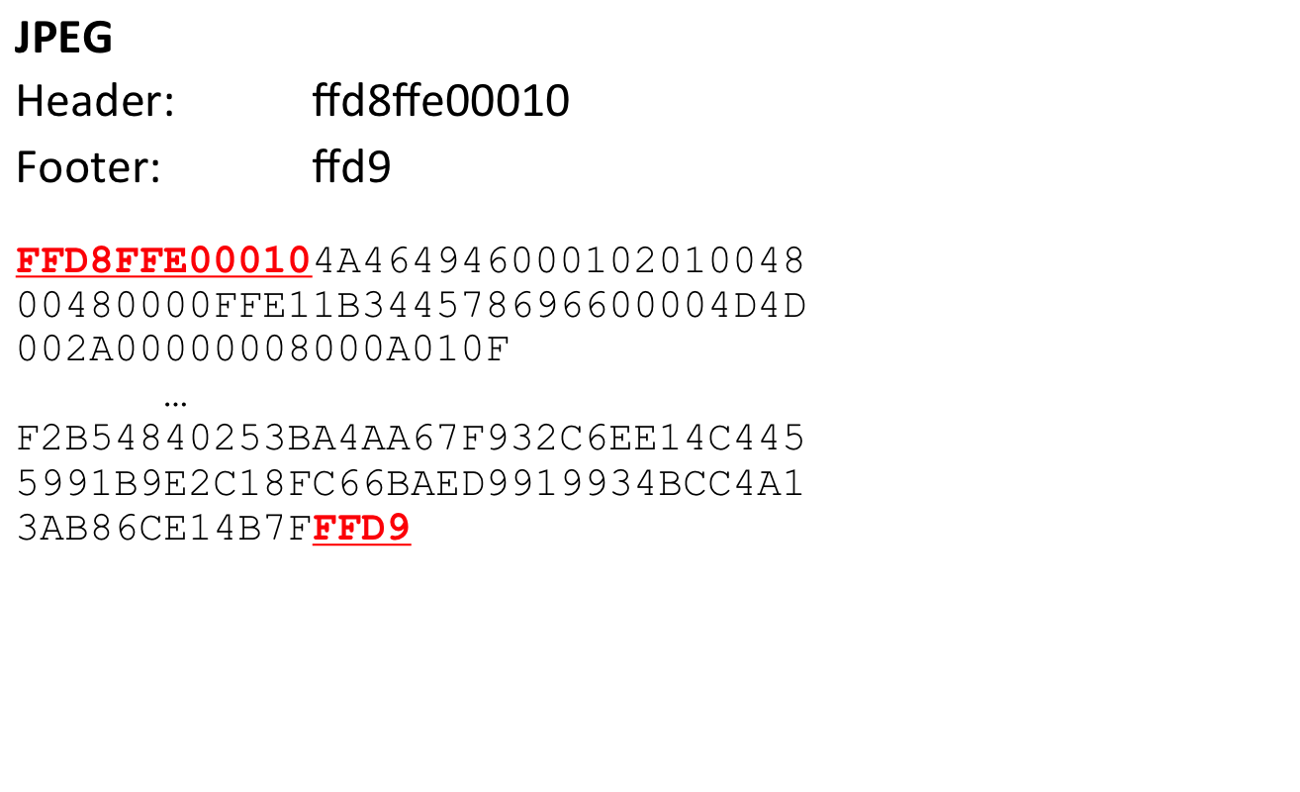
File Carving
File Carving - a technique used to recover files or fragments of files when corrupted, missing or purposely deleted.
CS 151 - Fall 2018
CS 151.1001 – Fall 2025
Notes:
Additional Notes:
Not all data can be carved
File carving is done in the slack and free space
Headers and footers help with the file carving process and can be used even if file extension has been renamed
Overwriting with zeros.

Slide 19

Forensic Procedures
Collection Examination Analysis Reporting
Reporting
Summary
Scope and Objectives
Examination Results and Details
Conclusion
Supporting Documents
CS 151 - Fall 2018
CS 151.1001 – Fall 2025
Notes:
Additional Notes:
Process needs to be legally justifiable method and techniques
Relevance is based on the scope and objective of the investigation
Integrity of data includes imaging and chain of custody
Conclusions may include recommendations
Technical Writing vs. Creative Writing: no need for fancy words

Slide 20
What are Metadata and ExifTool?
Metadata – data that provides information about other data, useful to find information about file creation, access, and author.
MAC – file metadata containing Modified, Access, and Creation dates and times.
ExifTool– a command-line interface used for reading, writing, and editing metadata.
For our exercise, will only utilize the reading feature of Exiftool
CS 151.1001 – Fall 2025

Slide 21
Discussion Questions
Is digital photo metadata useful as evidence? Is it viable/absolute? What would make it useful or not useful?
Can the fields in the metadata be altered? Could we tell if the metadata in a photo had been altered?
Are there privacy concerns? What are they?
What should be communicated to students about photo metadata? How can this be applied to the classroom?
CS 151.1001 – Fall 2025
Notes:
Additional Notes:
It is very difficult to determine, but one can set a 3rd party timestamp to avoid people seeing alteration of the data
Yes, because it stores PII, phone model, geolocation
Mention that Facebook strips away important Metadata
Phone tracks everything. Be careful with the things you take pics of...Digital footprints trace everything you do
ExifTool is freeware...student can take pictures and analyze exiftool data.

Slide 22
References
[1] NIJ - Forensic Examination of Digital Evidence: A Guide for Law Enforcement, https://www.ncjrs.gov/pdffiles1/nij/199408.pdf
[2] NIST – Guide to Integrating Forensic Techniques into Incident Response, http://csrc.nist.gov/publications/nistpubs/800-86/SP800-86.pdf
[3] NIST – Computer Forensics Tool Testing Handbook, http://www.cftt.nist.gov/CFTT-Booklet-08112015.pdf
[4] Belakasoft Research - Whitepaper, Retrieving Digital Evidence: Methods, Techniques and Issues, 2012, Yuri Gubanov https://belkasoft.com/retrieving-digital-evidence-methods-techniques-and-issues
[5] Computer and Information Security Handbook, 2nd Edition, 2013, John Vacca, Editor. Part III – Cyber, Network and Systems Forensics Security and Assurance.
CS 151.1001 – Fall 2025
Notes:
Additional Notes:
Hashing = mapping algorithm functions. NOTE IT IS ONLY ONE WAY
Hex editor = number systems
Geolocation = coordinates
Exiftools = privacy
Verification = credibility (cite sources) - Truthful with things you find and you didn’t change it in any way
Reports = written communication

Slide 23

Acknowledgements
This material is based upon work supported by the National Science Foundation under Grant No. 1855159.
File carving images based on those provided by Mr. Todd Shipley, CFE, CFCE President & CEO Vere Software.
CS 151.1001 – Fall 2025

